Slide 1

Cyclistic Case Study
Presented by: Chris Fields
Last Updated: November 3, 2022

Slide 2

Objective:
Cyclistic is designing a new digital media strategy, focused on converting casual riders into annual members.
Identify the key differences in bicycle usage between Cyclistic’s annual members and their casual riders.

Slide 3
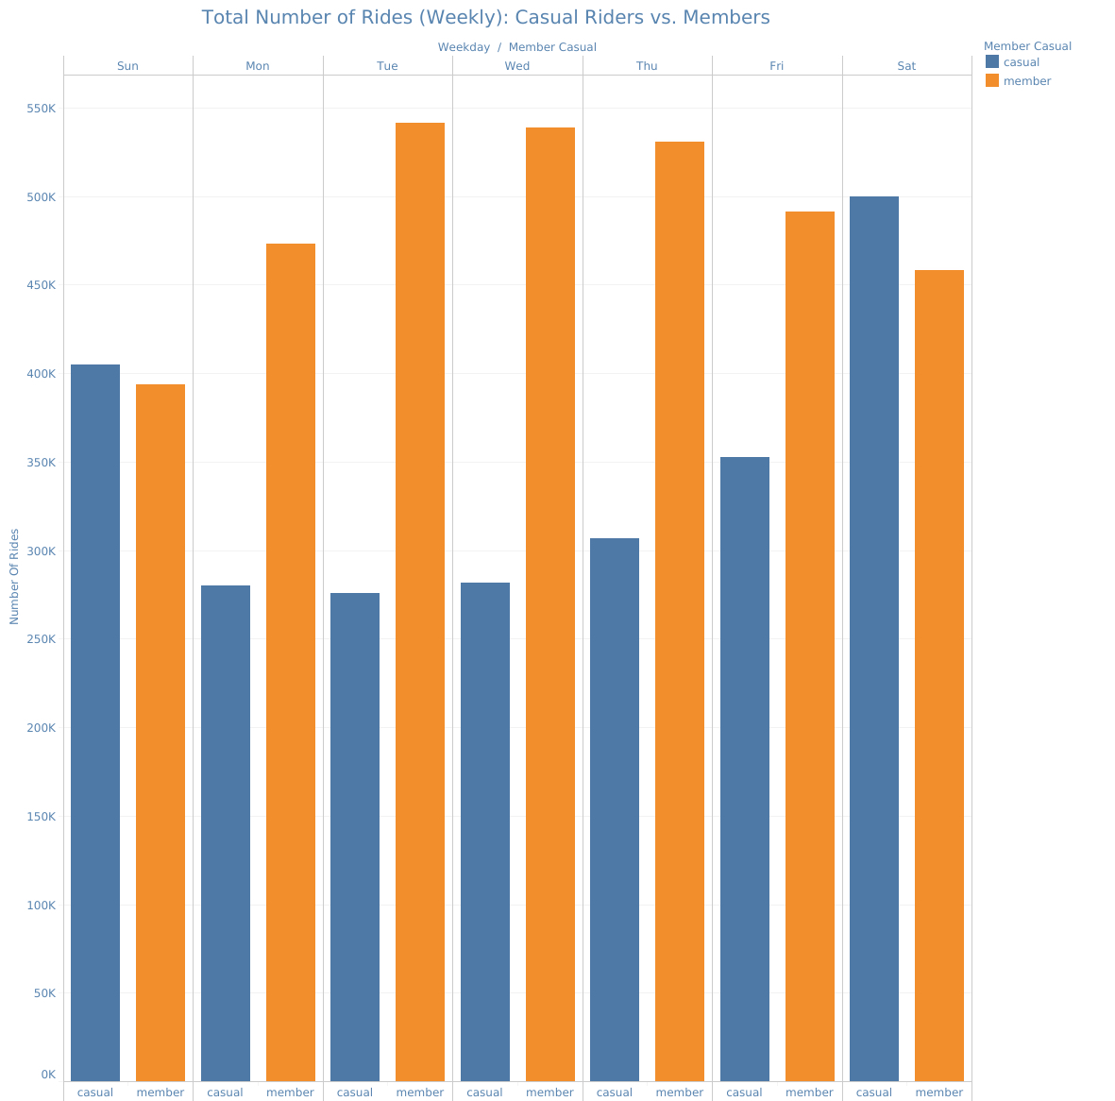
Weekly Data
The greatest divergence in ridership occurs during the work week, when members complete the greatest number of rides.

Slide 4
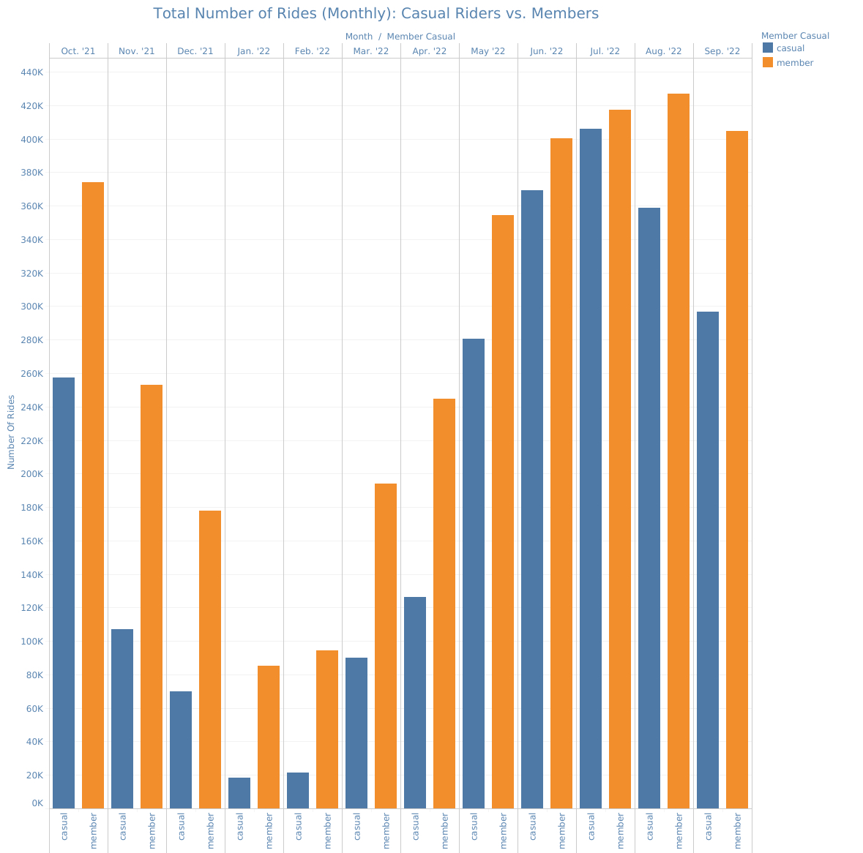
Monthly Data
Casual ridership peaks in July, while member usage overshadows casual riders from late summer to early spring.

Slide 5
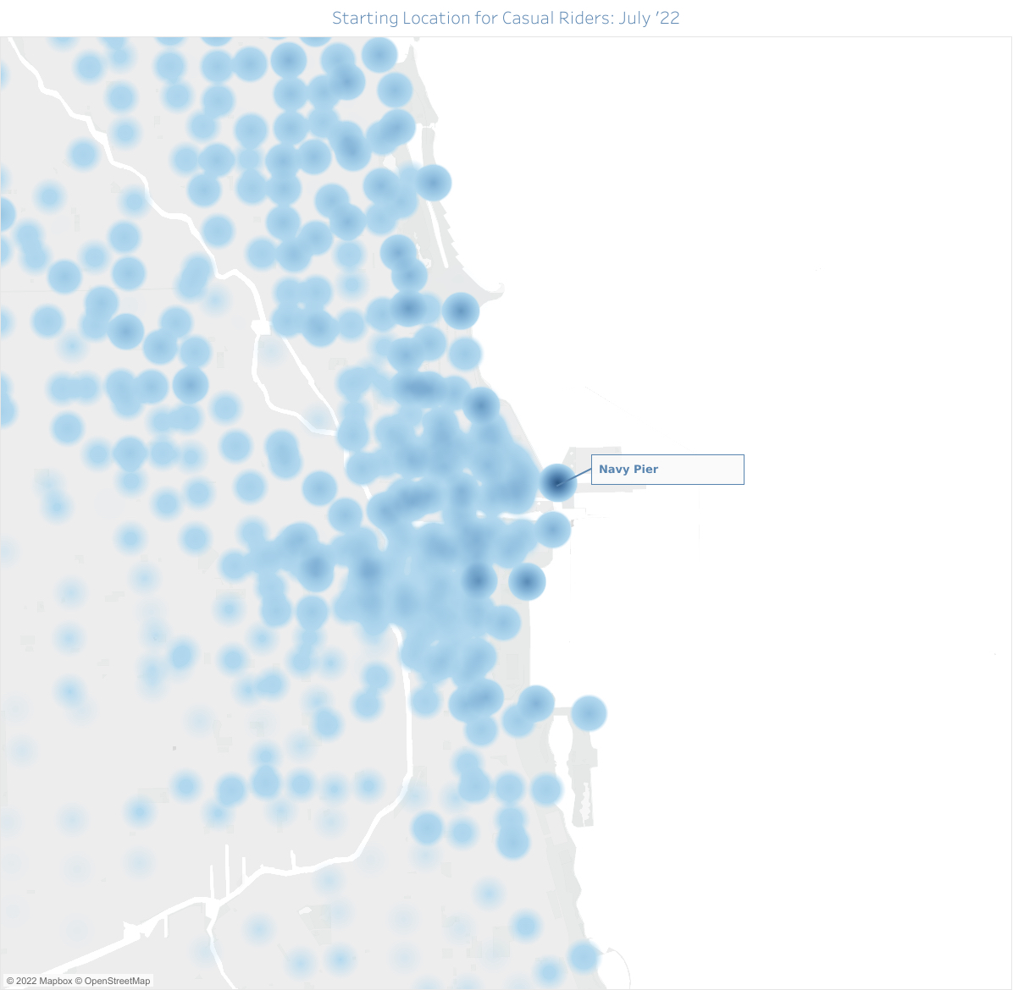
Geographic Data
Navy Pier is the most popular starting point for casual riders during their peak month of July.

Slide 6

Conclusion
Casual riders who complete more rides during the work week should be a focus of the campaign.
An annual membership which rewards commuters would be an effective incentive.
The campaign would be most effective during the month of July.
Brand visibility would be reinforced by the large number of riders throughout the city.
The location-based element of the campaign should target casual riders at Navy Pier.
A localized push notification, paired with the visual of fellow riders, would strengthen brand appeal.

